Slide 1
Association of Music & Memories
Casey Nguyen, Kayla Patterson, Caroline Tran, Sophie Wu

Slide 2
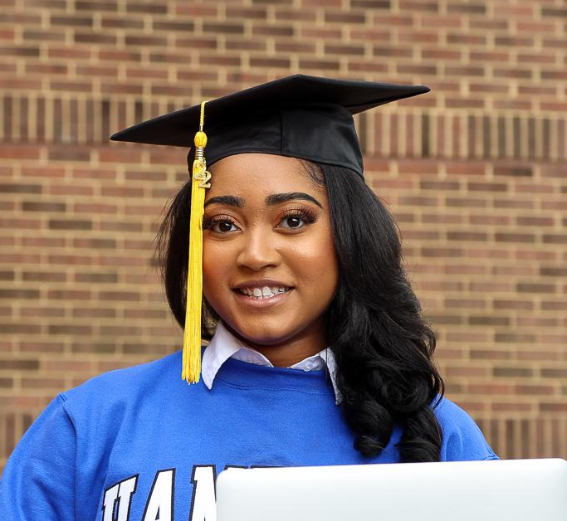

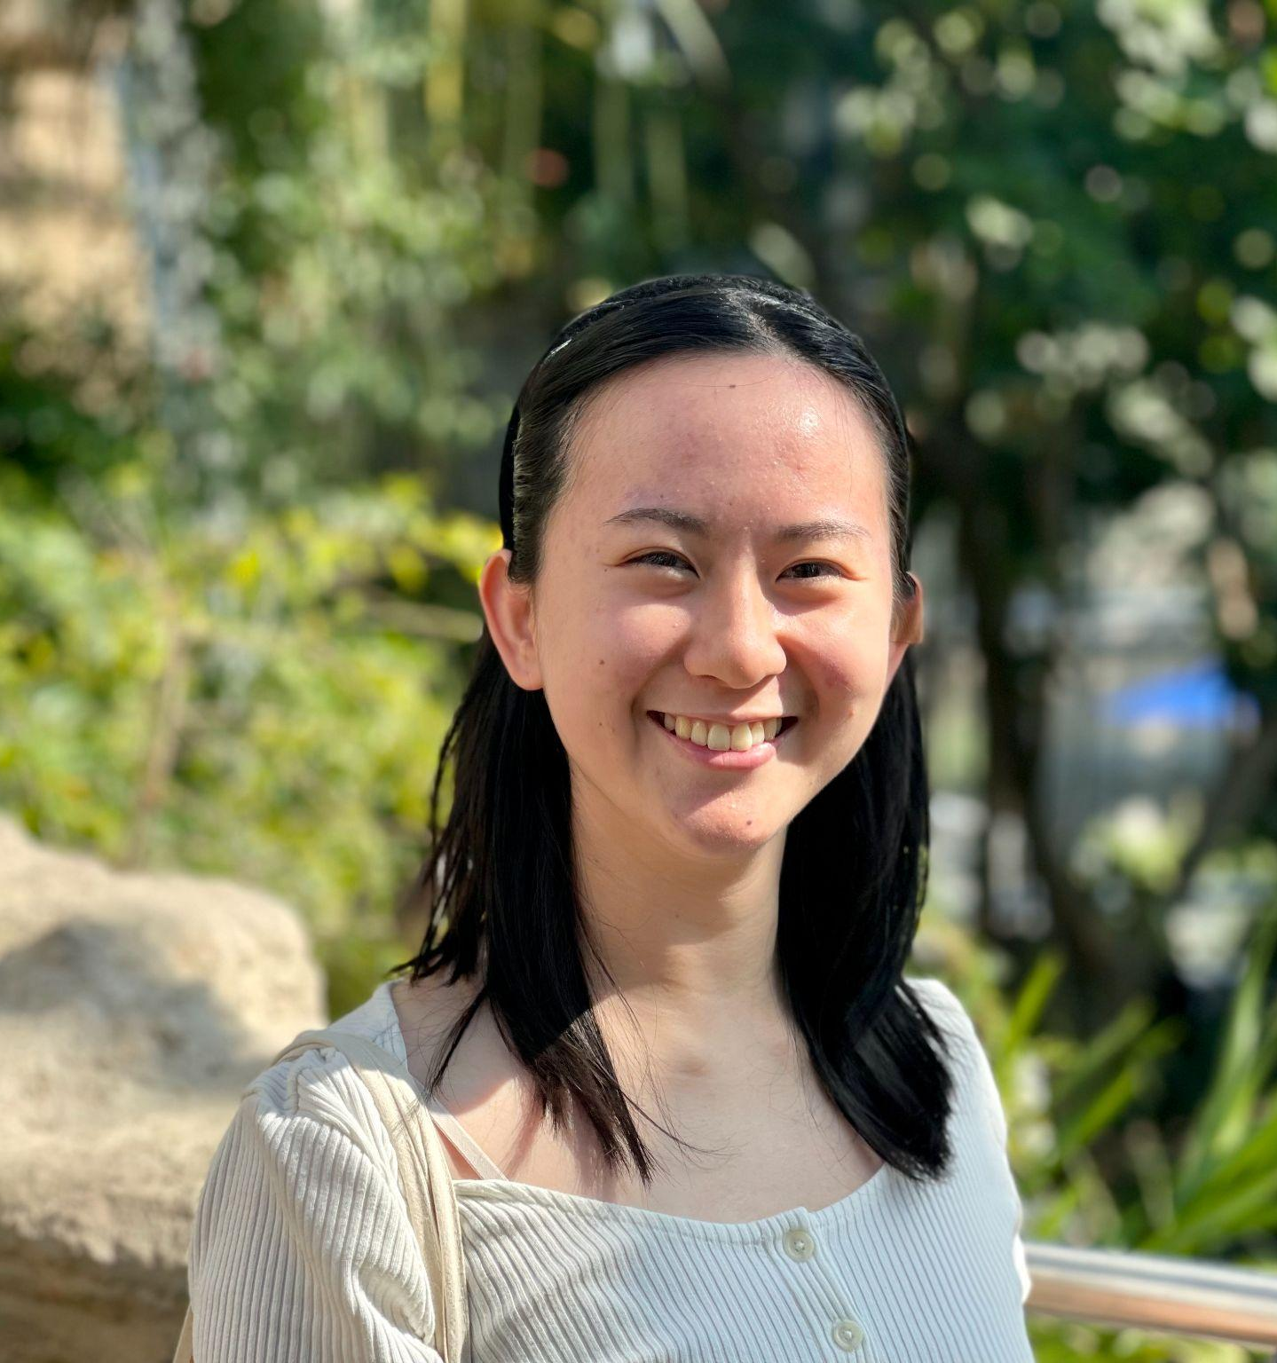
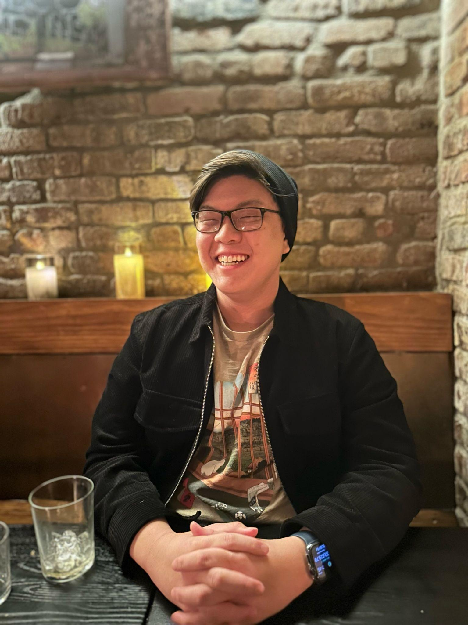
Meet the Team
Casey Nguyen
BSCS ‘24, MSCS ‘24
California
Kayla Patterson
MSCS ‘24
New Jersey
Caroline Tran
BSCS ‘23, MSCS ‘25
Washington
Sophie Wu
BSCS ‘24, MSCS ‘25
Minnesota

Slide 3
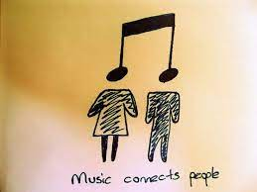
Problem & Domain of Interest:
Harmonious Ties: Connection Through Music
WHAT: Finding connections between music and people
WHY: Music relates to everyone in different ways
HOW: How can we use music to help people preserve and journal memories & events in their life?
Notes:
What is it and why/how did we choose it?
What is harmonious ties: connection through music
Why did we choose this theme
How did we choose this theme

Slide 4
Needfinding Methodology
Notes:
Participants: Why were they chosen? Why are they appropriate? How were they recruited/compensated?
Where were the interviews conducted?
Who was your “extreme user”? In what axis are they extreme?
What did you ask?
Team member roles for each interview
Apparatus – any equipment/software used (transcribing, etc.)

Slide 5
Needfinding Methodology
Participant Search:
Acquaintances (2nd-3rd degree social connections)
Cold-emailing Stanford Faculty
Posting on Palo Alto/Mountain View subreddit
Notes:
Participants: Why were they chosen? Why are they appropriate? How were they recruited/compensated?
Where were the interviews conducted?
Who was your “extreme user”? In what axis are they extreme?
What did you ask?
Team member roles for each interview
Apparatus – any equipment/software used (transcribing, etc.)

Slide 6
Needfinding Methodology
Participant Search:
Interview Process:
Acquaintances (2nd-3rd degree social connections)
Cold-emailing Stanford Faculty
Posting on Palo Alto/Mountain View subreddit
Teams of 2:
  1 Interviewer
  1 Notetaker
Audio recorded if possible + real-time transcribing on laptop
Notes:
Participants: Why were they chosen? Why are they appropriate? How were they recruited/compensated?
Where were the interviews conducted?
Who was your “extreme user”? In what axis are they extreme?
What did you ask?
Team member roles for each interview
Apparatus – any equipment/software used (transcribing, etc.)

Slide 7
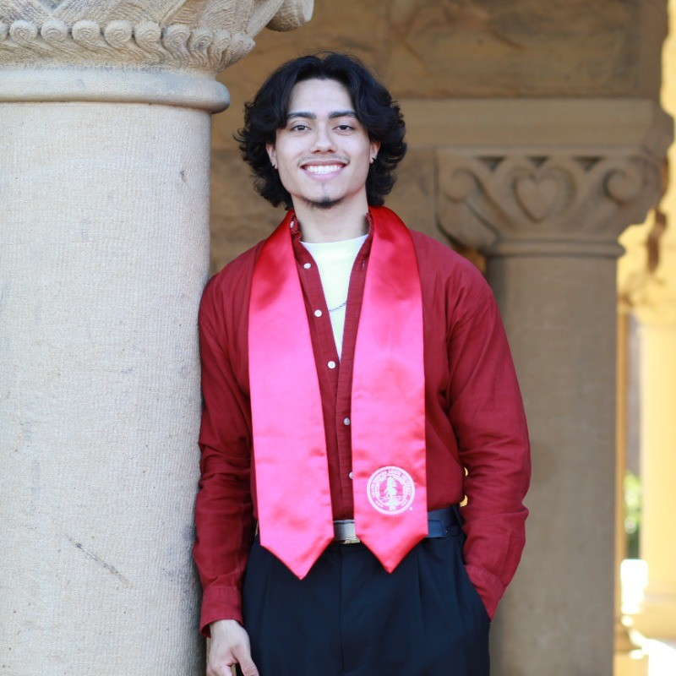

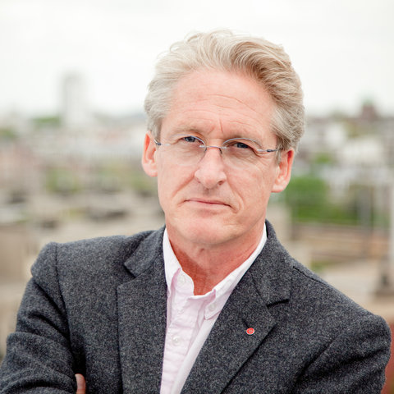
Participants
Bryant Jimenez
Diana Jones
Michael Shanks

Slide 8
What We Asked
General Music Engagement
  Describe the last time you incorporated music into a daily routine
Collaborative Music Experience & Social Interaction
  Do you ever share music or song recommendations with friends or family? How do you usually share them?
Personal Preferences & Music Exploration
  Lately, which genres or artists have resonated most with you? Can you pinpoint why?
Memory, Emotional Connection & Personal Experiences with Music
  Tell me about a song or an instrument that brings you to a special moment in your life.

Slide 9
Bryant Jimenez
Why did we choose him?
  Considers music as part of his identity
  Heavy listener of music
  Additional experience in composing and producing music
Why is he an “extreme user”?
  High Engagement
  Music as Routine
  SoundCloud Creator
Student @ Stanford (Extreme User)
Team: Casey (Interviewer) & Sophie (Notetaker)
Location: Tresidder
Recruited: Mutual Acquaintance (Friend of a friend)
Compensated: No
Apparatus: Laptop (notes), Phone (recording)
Notes:
Musical Evolution: Explored his transition from early video game music to diverse genres like rap, J-pop, and Spanish music.
Music's Role: Investigated how music influences his daily routines, moods, and social interactions.
High Engagement: Bryant stands out because he dedicates a significant portion of his day, approximately 3 hours, to listening to music.
Music as Routine: More than a hobby, music is deeply intertwined in almost all aspects of his daily activities, making him a highly engaged user.
Variety & Depth: His musical palette is rich and varied, crossing several genres and cultures.

Slide 10
Bryant Jimenez - Stanford Student
Quotes
“There’s this one song where [J. Cole] talks about seeing this girl for the first time in his math class and that’s pretty much how I met my girlfriend.”
“Whenever “Feel No Ways” by Drake comes up, the time that comes to mind is [when] I was on a bus [as an RA]...played that song, everybody enjoyed it…helped all the kids bond with each other.”
Surprising Facts:
Avoids Taylor Swift's music because of the inconvenience her concerts causes him in Denver.
Doesn't like commercial-sounding tracks that feel made for specific settings, like Harry Styles' "Music for a Sushi Restaurant."
Listens to songs with lyrics he doesn’t relate to or condone

Slide 11
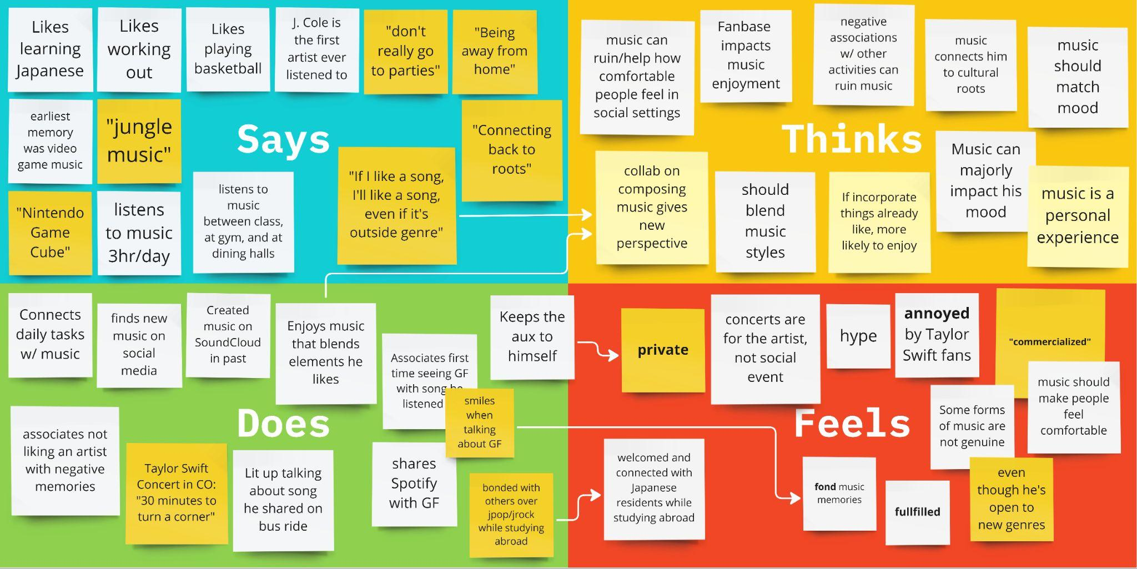

Slide 12
Before Japan, he would maybe would listen to 3-4 Japanese songs, but once got there, friends would show introduce him to new songs, and he really enjoyed it.
Discovering new music framed a part of his identity while studying abroad
Branches out into new genres such as JPop/JRock but also Spanish/Mexican music to reconnect with his heritage.
Felt excited and embraced when Japanese DJs played American songs to welcome him.

Slide 13
Insight
Need
In Japan, music was a cultural bridge and self-discovery tool for Bryant.
There's a demand for avenues that empower individuals to explore and immerse themselves in diverse musical genres.
Notes:
Insight: Immersion in a new culture can heighten one's appreciation for unfamiliar music, enriching their self-awareness and cultural understanding.
Need: Such experiences not only facilitate personal growth but also elevate overall cultural immersion.

Slide 14
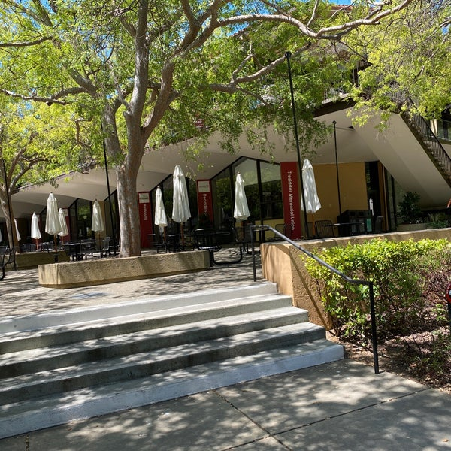
Pictures/Artifacts
Tresidder (Interview Location)

Slide 15
Diana Jones
Why did we choose them?
  Represents an “average user”
  Works professional 9-5 job
  Casual listener
    Uses music as background noise
  Considers herself “musically untalented”
Program Coordinator @ Stanford
Team: Casey (Interviewer) & Kayla (Notetaker)
Location: Stern Dining Hall
Recruited: Friend of a friend
Compensated: No
Apparatus: Laptop (notes), Phone (recording)

Slide 16
Diana Jones - Program Coordinator @ Stanford
Quotes
“When I’m cooking, I get very nostalgic because I am using my mother’s recipes for something I know that I used to eat alongside my brothers.”
“When I was writing my college applications…I had the same song playing on repeat…It worked both as background music and encouraged me to type faster.”
Surprising Facts
Initially, she wasn’t fond of country music. But after a concert in Dallas, her perspective shifted due to the environment and vibe.
While she finds Spotify a primary music source, she wishes for more social interaction on the platform without it turning into a social media app.

Slide 17
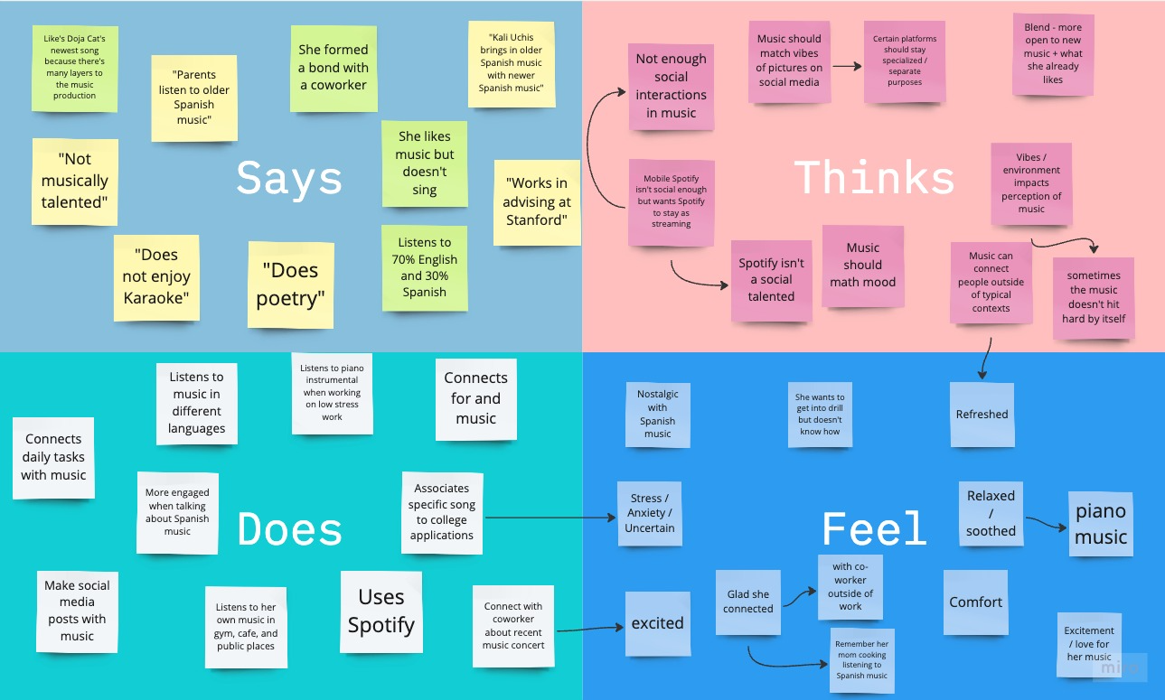

Slide 18
Says 30% of music she listens to is in Spanish
More open-minded to different music when it incorporates what she already likes.
Connected with coworker recently through a Spanish-speaking artist’s concert
Feels a profound connection to her Spanish heritage, especially when listening to Spanish music or cooking traditional family recipes.

Slide 19
Insight
Need
For Diana, Spanish music serves as a powerful connector to her heritage, evoking deep feelings of nostalgia and belonging.
A desire to discover and connect with cultural roots through music, allowing one to journey through their heritage and memories.

Slide 20
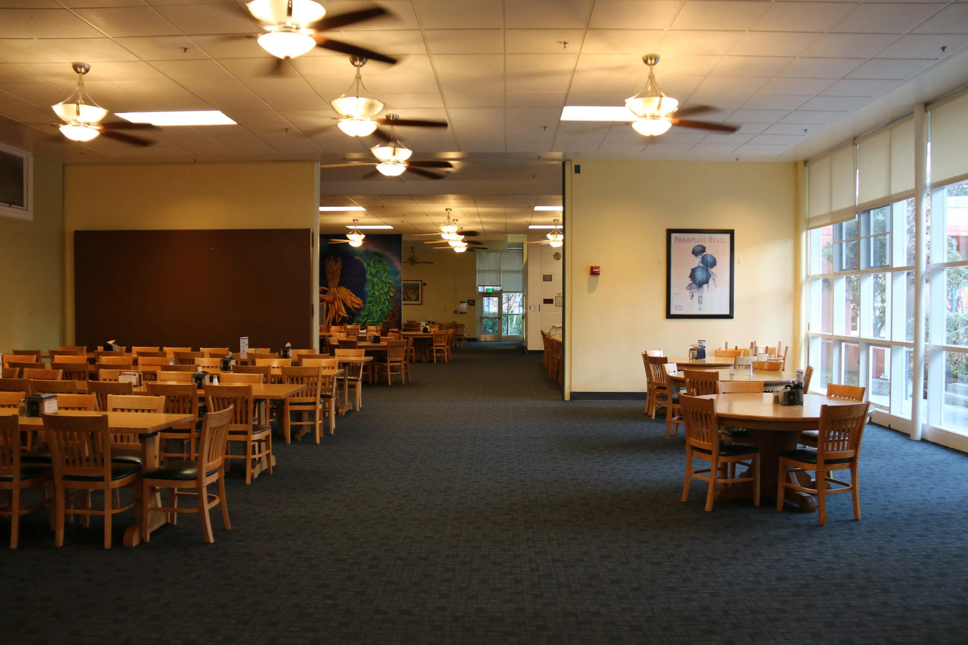
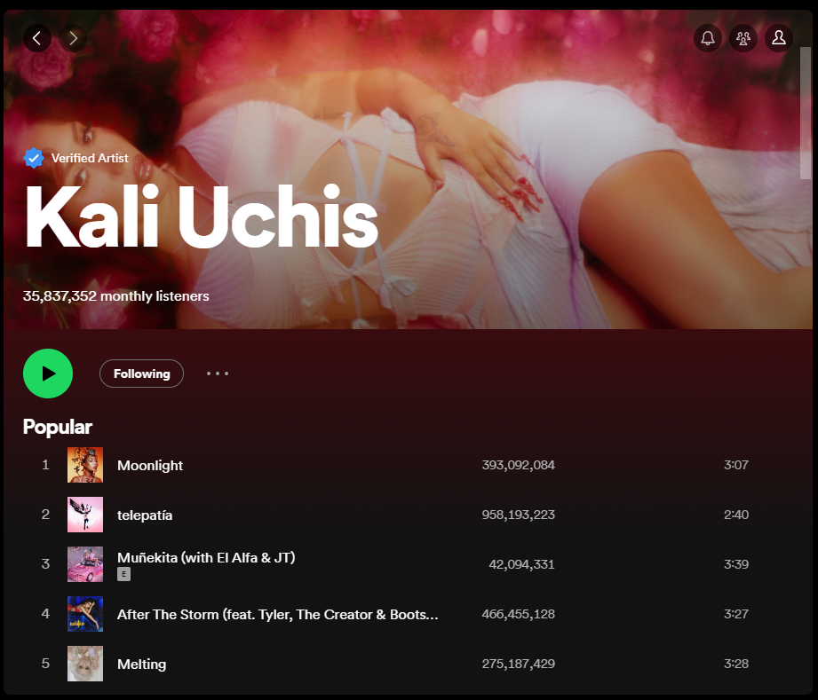
Pictures/Artifacts
Stern Dining Hall (Interview Location)

Slide 21
Michael Shanks
Why did we choose him?
  Diversity in demographics
    Older
    Non-American (UK)
  Deeply engaged with the humanities
  Likely has a different perspective on music due to academic background
Professor of Classics @ Stanford
Resident Fellow @ Ng Humanities House
Team: Sophie (Interviewer) & Caroline (Notetaker)
Location: Ng House
Recruited: Resident Assistant of Ng House
Compensated: No
Apparatus: Laptop (notes), Phone (recording)

Slide 22
Dr. Michael Shanks - Resident Fellow @ Ng
Quotes
Music is “haunting, the return of what was lost”
“ Memory does not represent the past…It’s not a picture…What is a memory? It’s a key to experience. Our experience is inconceivable without memory”
Surprising Fact
His wife (professional) and both of his daughters are musicians
He is involved in theater archaeology

Slide 23
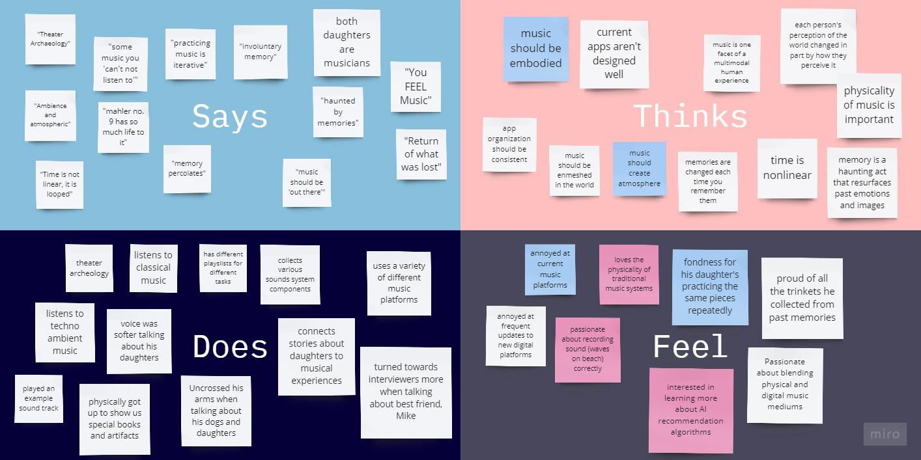

Slide 24
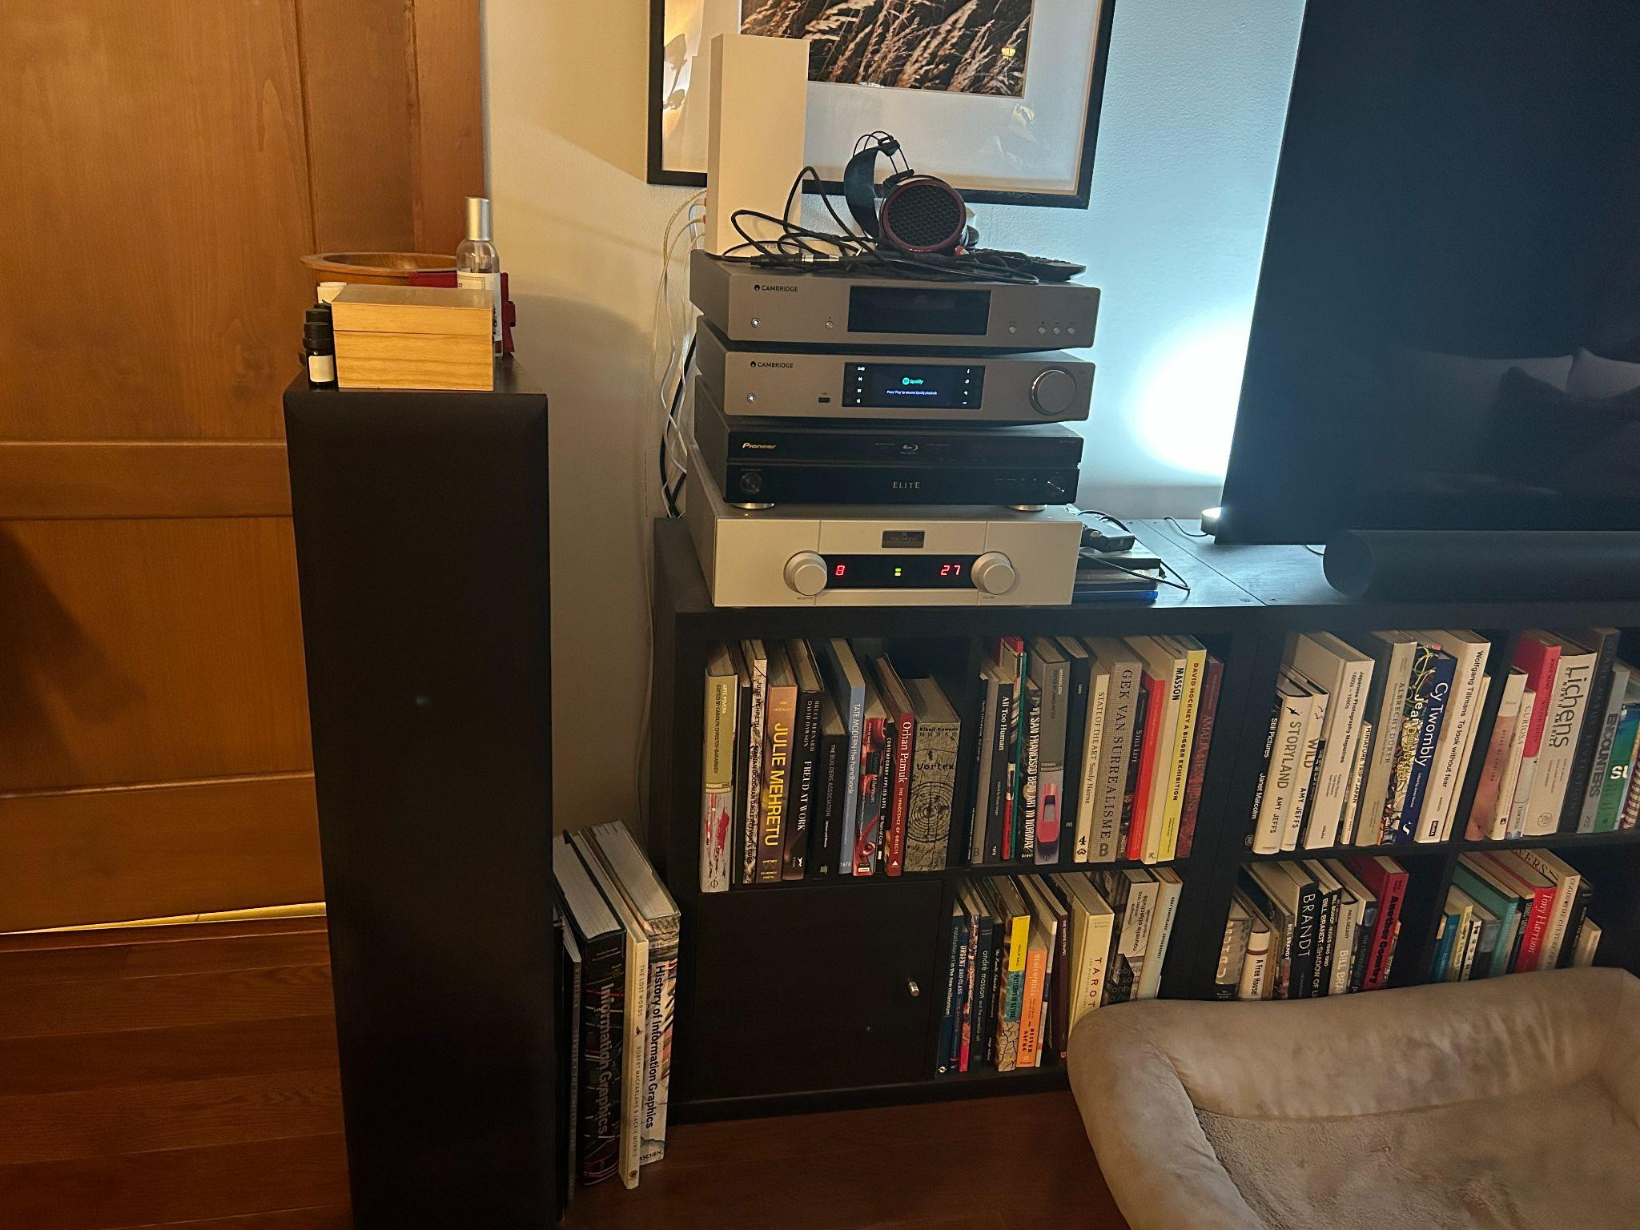
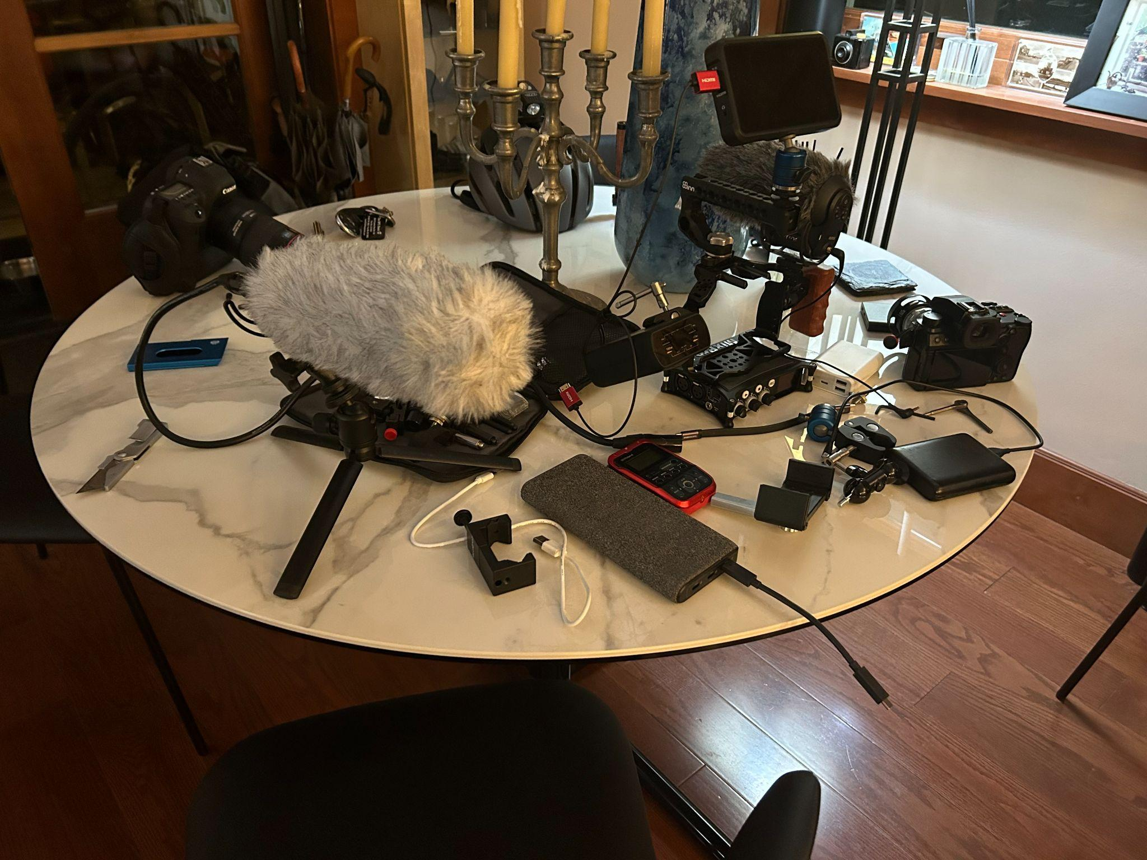
Pictures/Artifacts
Dr. Shanks’ Sound System and Recording Equipment
Notes:
Sound System (left): Shanks specifically points out his sound system to us, and notes that some of it is very high-end/expensive/top of the line. He says some of it was gifted to him. Uses it to play/listen to music while he’s in/around the first floor living areas
Recording Equipment (Right): In parts of his efforts to record waves on a certain beach in Denmark—however, he says he still can’t quite get the recording right. Still trying to search for the “right” microphone

Slide 25
Insight
Need
There is a profound connection between sound, memory, and our perception of history. Music is a temporal and emotional bridge.
There's a need for platforms that intertwine sound, memory, and historical context, enabling a richer multisensory exploration of the past.

Slide 26






Key Learnings:
Lasting and renewable connection between music and cultural roots
Musical impact also relies on the environment and physical medium
Blend of musical interests are positively accepted from our interviewees

Slide 27
What’s Next
Deep Dive & Identify Challenges
  Explore traditional and modern memory-keeping techniques to pinpoint common patterns in memory and musical relations.
Engage with Diverse Groups
  Interview varied age groups and backgrounds to gather a holistic understanding blending musical styles and collaboration.
Brainstorm & Prototype Solutions
  Develop innovative methods or tools to address identified challenges.
Feedback & Refinement
  Test prototypes with a target audience, collecting feedback, and making necessary refinements to ensure effectiveness and user satisfaction.

Slide 28
Thank You!

